Slide 1

Go To Market Bot

Slide 2
What’s Chatbot?
A chatbot is a conversational agent that interacts with users using natural language.
Numerous applications of chatbots such as Customer Service, call centers etc
You must have used them once

Slide 3
GoToMarketBot
FROM ‘SUFFICIENCY’ TO ‘EFFICIENCY’
It is an Enterprise Chatbot, a conversation agent that works through artificial intelligence software developed according to the needs and utility of a particular scenario, which in our case will be to manage the retail merchandiser team of LG operating from different locations and retail stores.
Our Chatbot will be designed for the merchandisers to :
* Mark Attendance with current GPS location update.
* Submit Display Product Status with uploaded images(photographs).
* Share Market Intelligence / Information.
* Report Daily Updates with click of a button.
Key Features of the Product :
* Instant Response with automatic time-to-time pop-up(alerts).
* Assist managing team with easy to keep track functionality
* Work Stress Busters with clear & timely reporting.
* Automating Business Operations for Visible Efficiency Gains due to fast communication.
--> Chatbots engage the employees over messaging platforms by asking relevant questions to contextualise the responses and automate over 40% of the processes.
7
Notes:
Food loss and waste reduction should be seen as a means toward achieving other objectives, including improving food security and nutrition, reducing greenhouse gas emissions, lowering pressure on water and land resources and can increase productivity and economic growth. The formulation of effective policies toward food loss and waste reduction requires comprehensive information as to how much and where – both geographically and along the supply chain – various foods are lost or wasted. FAO’s work on measurement and support to countries to take action to reduce food loss and waste is critical to tracking progress made by countries..

Slide 4
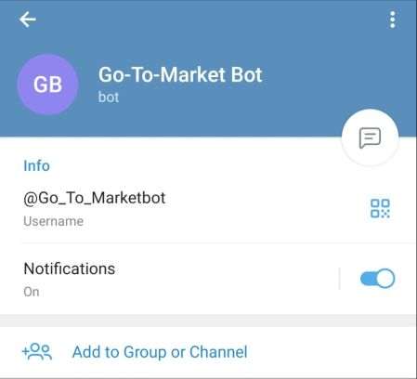
Prototype Video
Kindly refer to this implementation video, I have tried my best explaining my project hosting over different channels like Telegram and Microsoft Teams.
To Experience my project or test it, kindly type “Go-To-Market Bot” over telegram as demonstrated in the video.
*I didn’t have access to the company’s merchandiser data, I have given access to everyone , thus to test kindly use your EMAIL ID*.
*We can use lg official logo when the bot comes into use.
https://youtu.be/7rRr-QrRWck

Slide 5

GoToMarketbot
Business shift towards ChatBot
50% of businesses plan to spend more on chatbots than on mobile apps. 64% of internet users say 24-hour service is the best feature of chatbots. 37% of people use a customer service bot to get a quick answer in an emergency. There were over 300,000 chatbots on Facebook in 2018.
64%
37%
50%
GoToMarketBOT

Slide 6
The State of Food Security and Nutrition in the World, 2020 report
India is home to the largest undernourished population in the world
189.2 million people i.e. 14% of our population is undernourished
20% of children under 5 are underweight
34.7% of children under 5 years of age are stunted
51.4% women in the reproductive age (15-49 years) are anaemic
The Global Hunger Index 2020 ranks India at 101 out of 116 countries
25K+
LG has around 25k+ merchandiser only in India
That’s Huge
With the number only we can understand how hard it is for an admin to manage all of them.

Slide 7
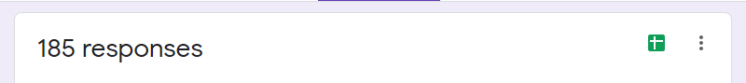
OUR STATs
60% of the merchandizers love to use more interactive way like chatbots.
11% via calls
27% via mobile applications etc.
2% want to go for meets.
AGE – 18 to 30
60%
want to use chatbot

Slide 8

Log In
Log off
DAILY ACTIVITY
Initialize the chat
Display Report
Authenticate
Market Intelligence Report
Attendance
ToDoList

Slide 9
Step 1
Chat with Telegram Bot sharing the details of location and Market Report
Step 3
Instantaneously the admin gets the confirmed location of the merchandiser
Step 2
Automated bot will compile the information and share it to the admin over Mail +
Store it in MS CosmoDB which can be retrieved as excel sheet
Step 4
At the End of the day admin can retrieve the Excel Sheet containing data from all employees.

Slide 10
Attendance
Send Email to admin
Instantly with location
OTP Sent + Verified
To Do List
Create
View
Delete
Initialize
Main Page
Automatically get’s updated to excel sheet
Market Intelligence Report
No
Relevant information sharing for respective markets
Display Report
Add .
View .
Delete
Update
Yes
Log Off

Slide 11
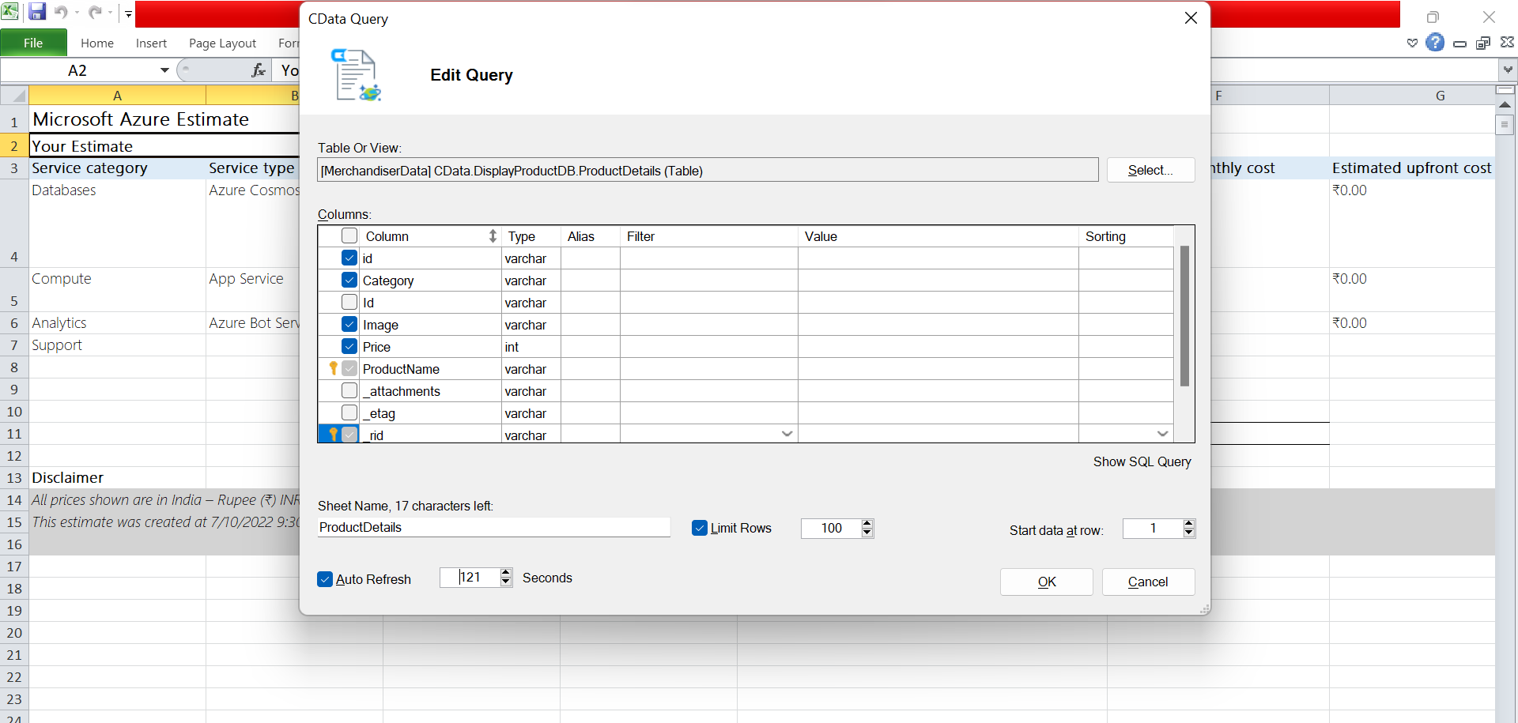
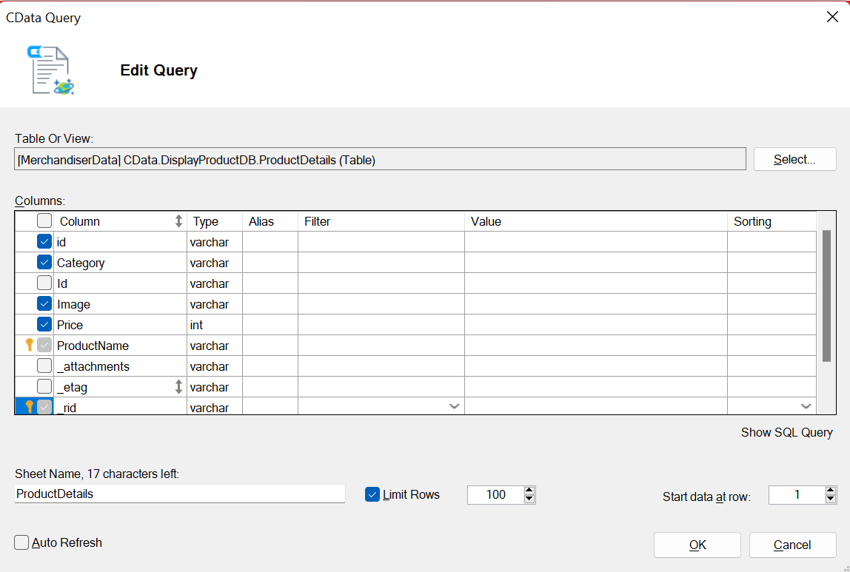

Slide 12
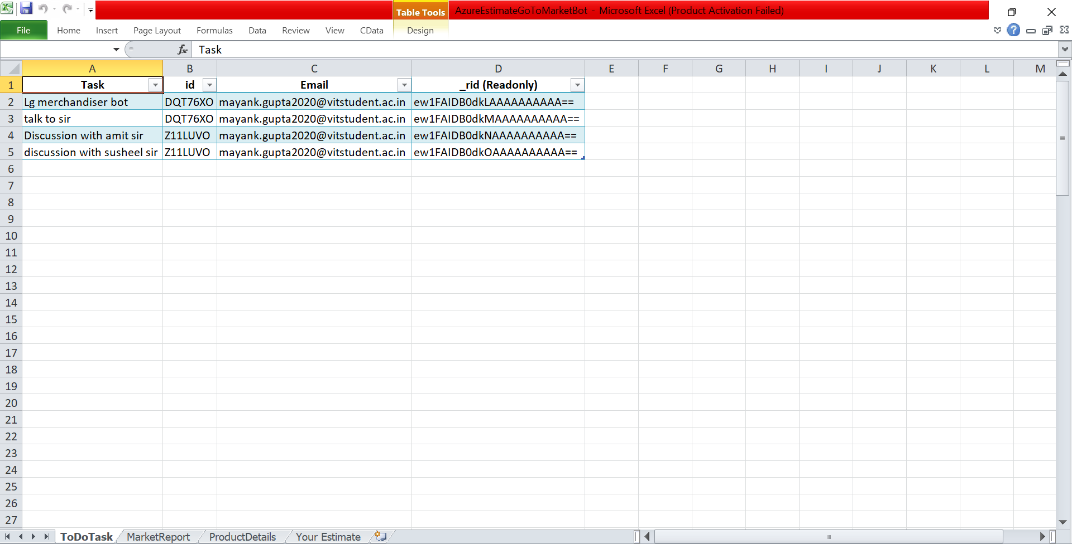
To Do Task Sheet

Slide 13
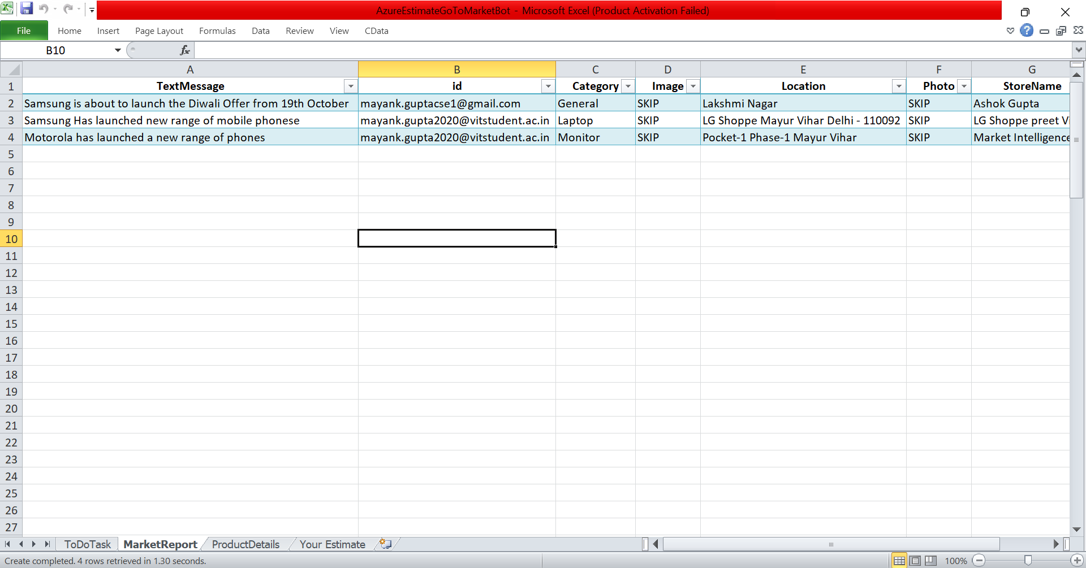
Market Report Excel Sheet

Slide 14
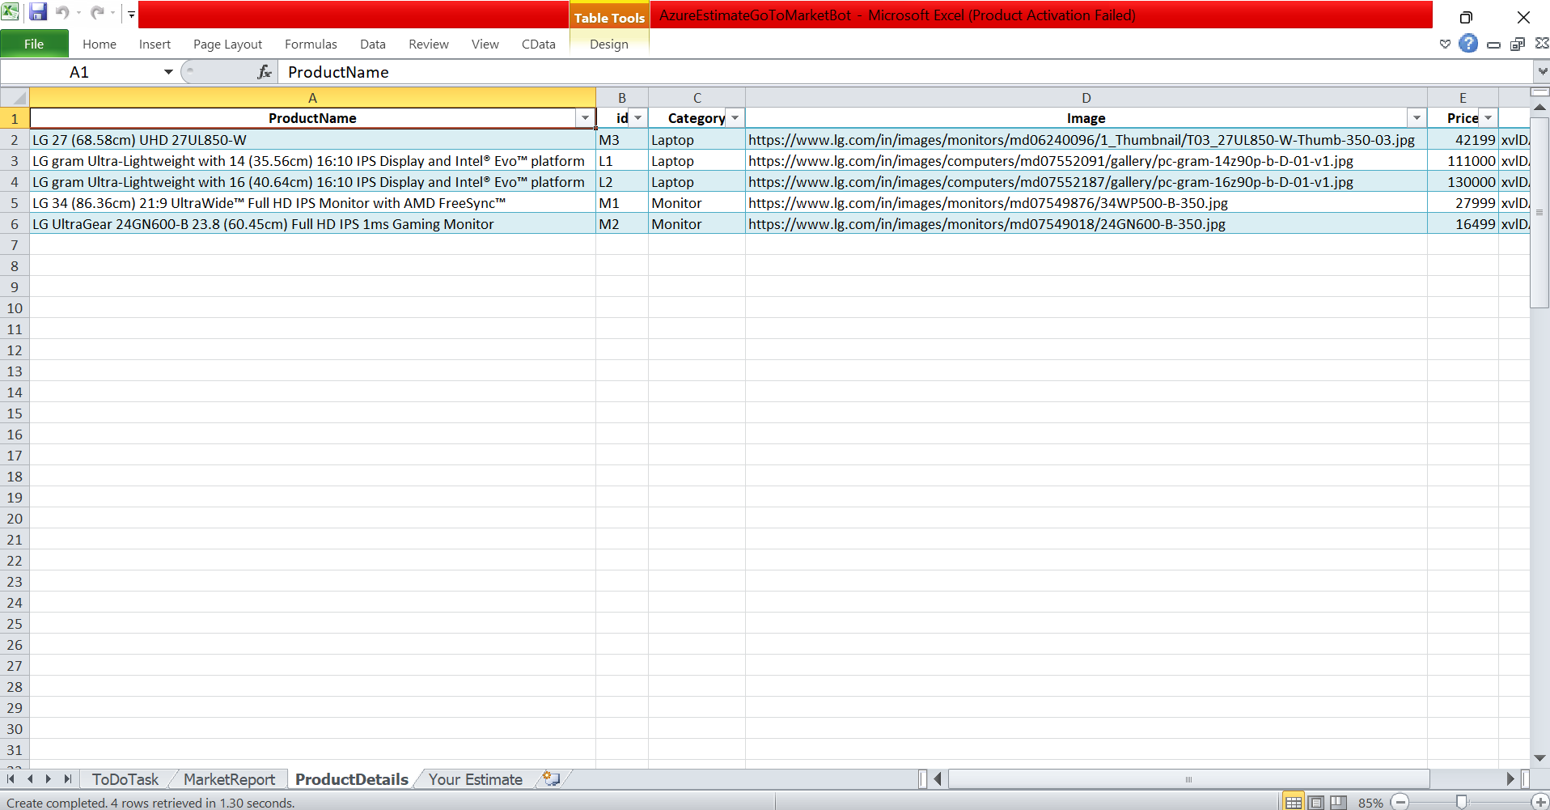
Display Product List Sheet

Slide 15
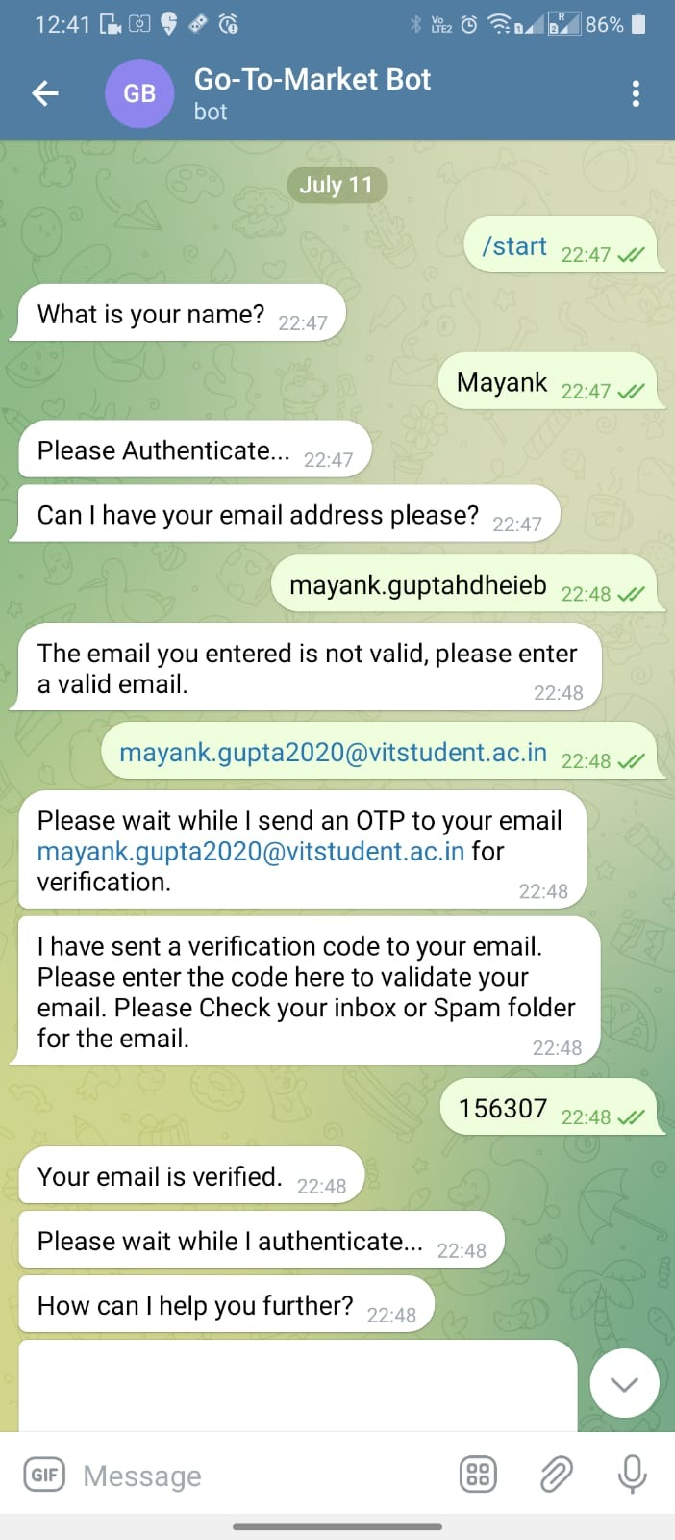
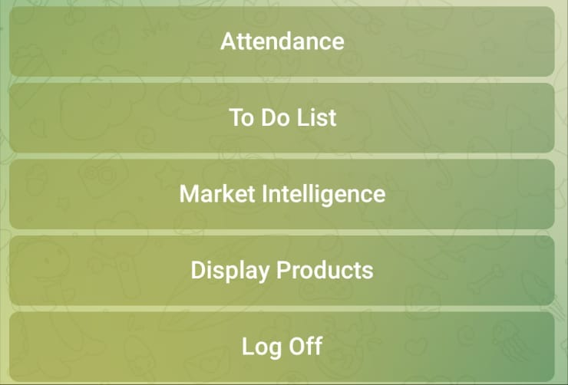
Main Page

Slide 16
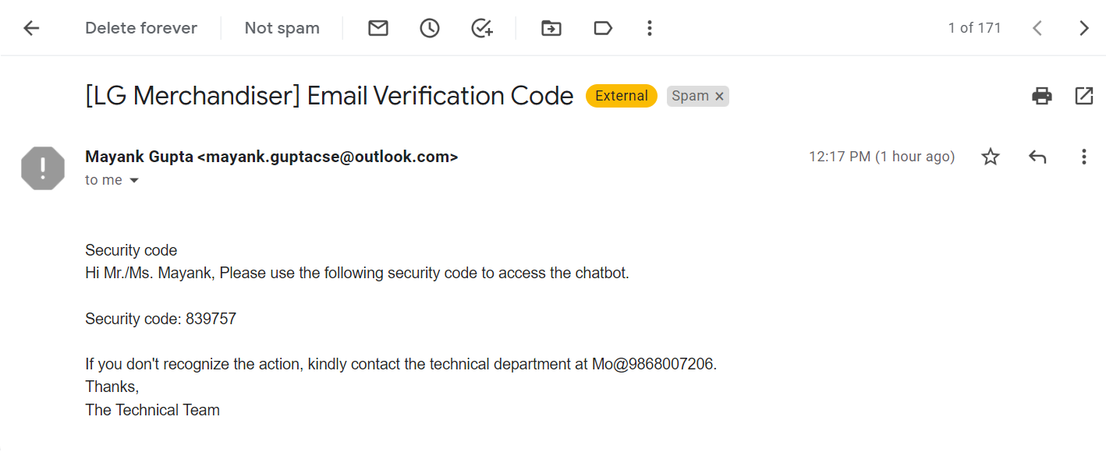
OTP AUTHENTICATION EMAIL SENT TO USER
Email sent to admin

Slide 17
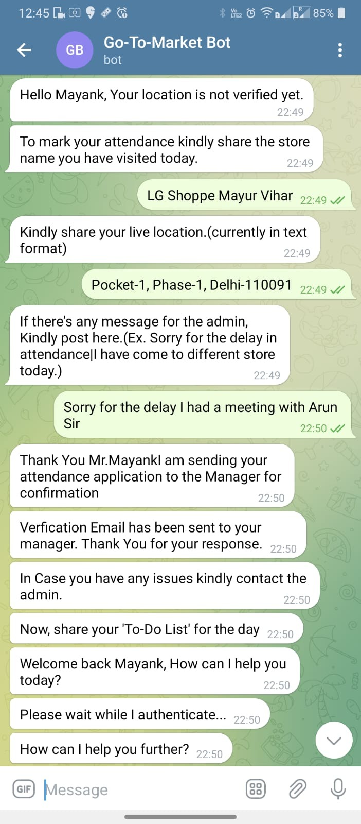
Main Page
Email sent to admin

Slide 18
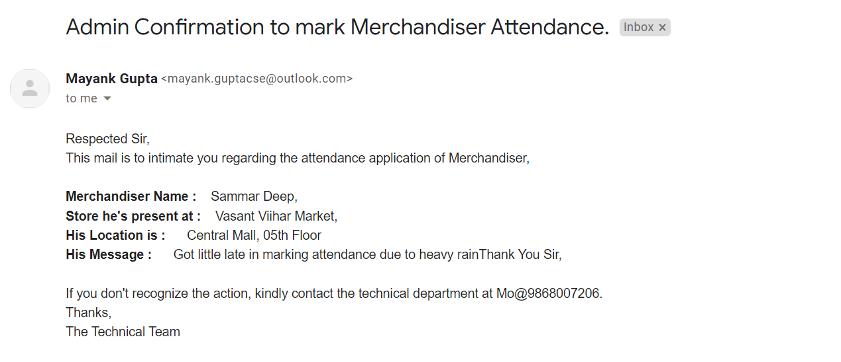
EMAIL SENT TO MANAGER/ADMIN IMMEDIATELY
Email sent to admin

Slide 19
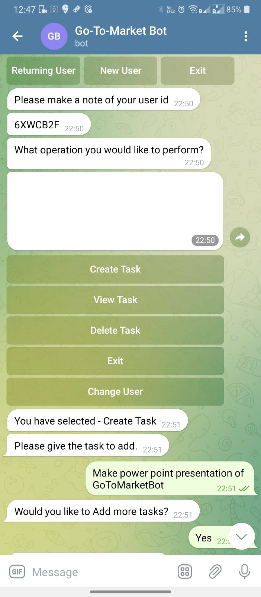
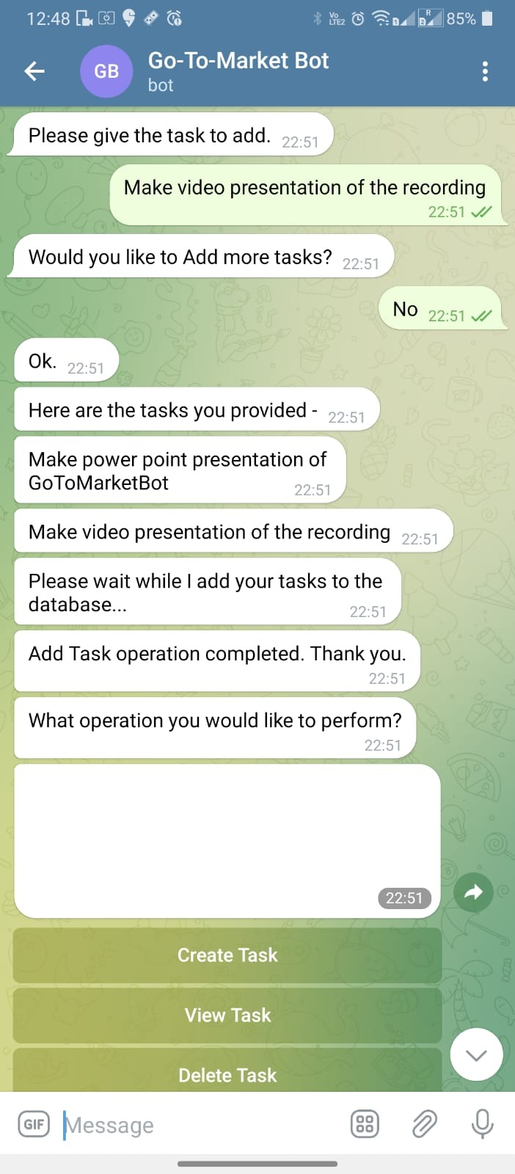
Main Page

Slide 20
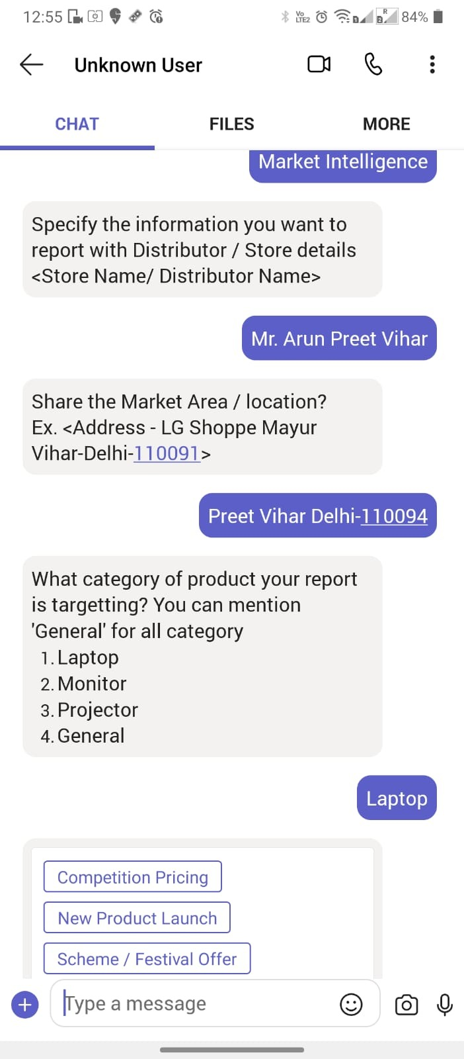
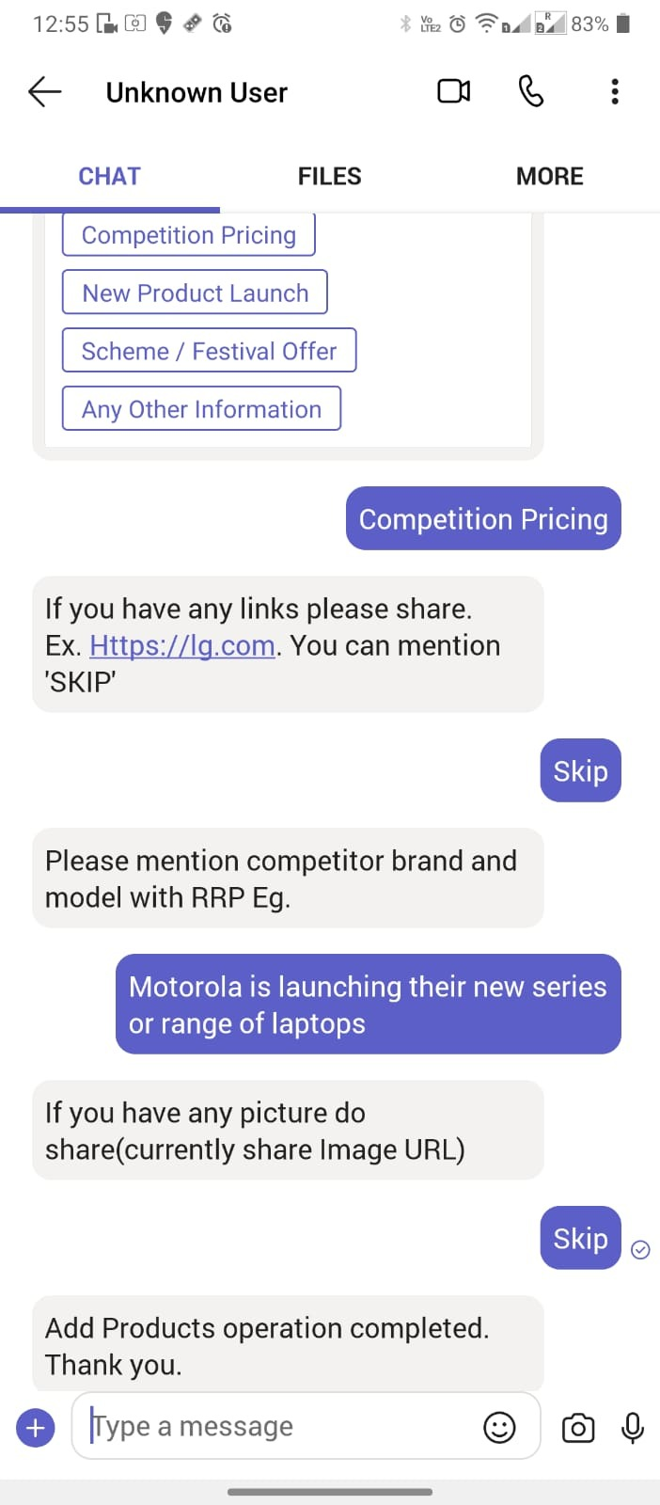
Channel MS Teams
Main Page

Slide 21
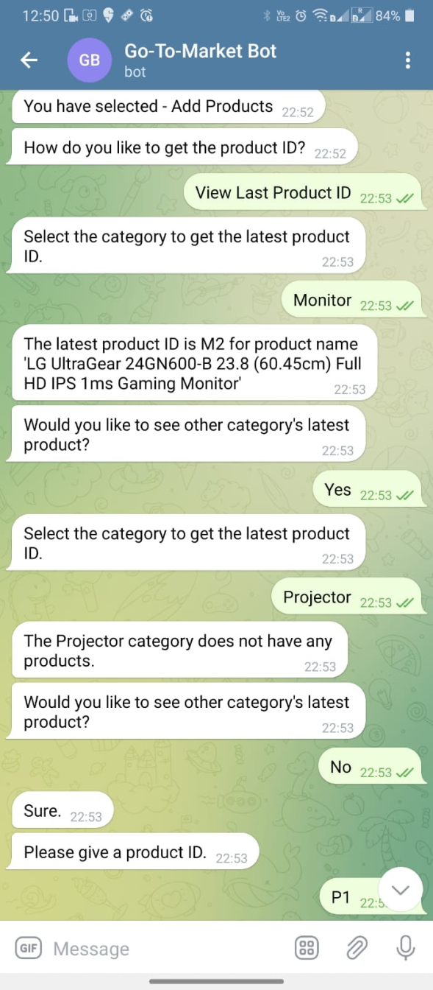
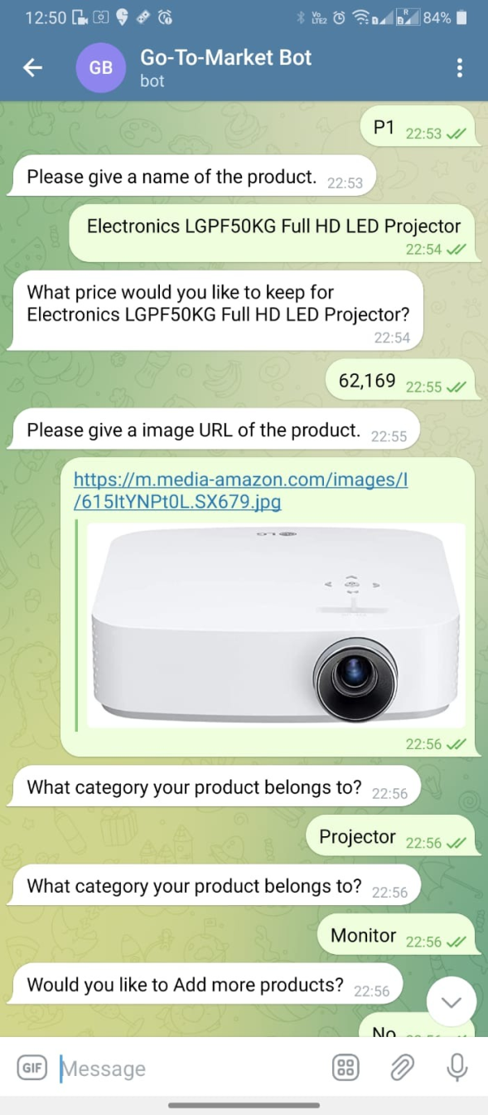
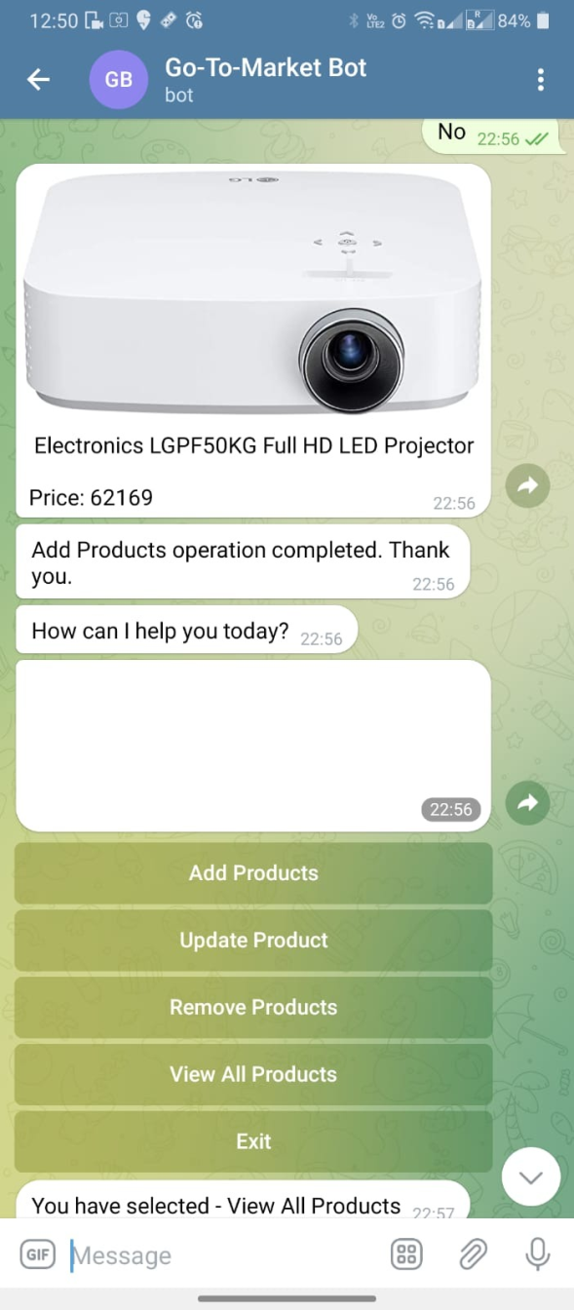
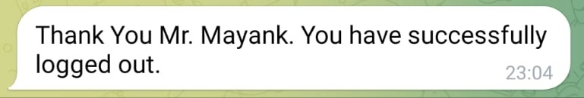
Main Page

Slide 22


Telegram
1.
Why telegram?
Telegram is the 10th most used social media platform worldwide
The average user of Telegram on Android
spends 2.9 hours per month
The Telegram app has been downloaded 220 million times in India since August 2021

Slide 23
S
W
Easy to share
OFFICIALS can easily share the report to the admin Immediately
Live Location
Will train the bot to take live location
Hustle Free
No Calls, No Extra App To Download
Natural Language
Resource Optimisation
We can train our bot to understand the natural language of the user.
Using Machine Learning model
Scalable
O
Virus / Bugs
Multiple Number of users can be added
T
With exposure over internet,
Tie-Ups
Recurring Cost
Same application can run over different channels Eg. MSTeams,
Wechat, Email …
A small but recurring amount of Funds paid to azure.

Slide 24
YOU HELD THROUGH !
Thank you!
Prepared by:
Mayank Gupta
.NET DEVELOPER INTERN (Under Dr. AMIT G. SIR)

